Slide 1
DEPI · DATA ANALYSIS SPECIALIST TRACK · FINAL PROJECT
UK Railway Performance &
Passenger Behavior Analysis
An End-to-End Data Analysis Project
Raw Data → Cleaning → Feature Engineering → EDA → Star Schema → Power BI Dashboard
📅 July 2026 | 👨‍🏫 Instructor: Dina Ezzat

Slide 2
OUR TEAM
Bilal Abo Nar
Team & Roles
01
Bilal Abo Nar
TECH STACK
Team Leader — Star Schema, 50+ DAX Measures, Full Dashboard Design
Python (Pandas)
Power BI · Power Query · DAX
Star Schema Data Modeling
02
Shehab El-Din Mohamed
Project Overview, Data Description & Data Understanding
03
Youssef Khalifa
Data Cleaning & Data Preprocessing
DATASET AT A GLANCE
31,653
Records
04
Zeyad Shaaban
Exploratory Data Analysis (EDA)
35
Final Columns (18 original + 17 engineered)
05
Esraa Nagy Nabih
Jan – Apr 2024
Key Insights & Recommendations
Date Range
12 / 65
Departure Stations / Routes
02

Slide 3
01
SECTION 01
Project Foundations
Understanding the idea, the data, and what we're solving for
PRESENTED BY SHEHAB EL-DIN

Slide 4
PROJECT OVERVIEW
Shehab El-Din
The Idea & The Goal
Our project, UK Railway Analysis, aims to analyze UK train journey data using Power BI and SQL — turning raw data into information that supports better decisions.
In any large transport company, thousands of operations are logged every day — journey details, ticket prices, payment methods, journey status — but in its raw form, this data is hard to use directly.
That's why the goal of the project was to apply the steps of Data Analysis to turn this data into reliable information that supports understanding network performance and decision-making.
KEY QUESTIONS WE ASKED
Which routes are used the most?
Which routes generate the highest revenue?
What are the main causes of delay?
How do passengers behave when buying tickets?
What factors affect overall network performance?
THE END RESULT
Answering these questions helps improve operating efficiency, raise service quality, and enhance the passenger experience — the results were delivered as an Interactive Dashboard that makes it easy to explore the data and track performance indicators clearly and quickly.
04
Notes:
We start by introducing the project idea and goal: analyzing UK railway journey data to turn raw data into information that supports decision-making.

Slide 5
DATA DESCRIPTION
Shehab El-Din
The Data We Used
We used the UK Railway Dataset from Maven Analytics, which simulates train journey data across the United Kingdom.
The data covers about 31.6 thousand journeys representing Q1 2024 — a volume large enough to run analysis on and extract results we can rely on.
Each Row in the dataset represents a single train journey, while each Column represents a specific piece of information about that journey.
KEY COLUMNS
Purchase Date
Journey Date
Departure Station
Arrival Destination
Ticket Type / Ticket Class
Ticket Price
Payment Method · Railcard
Journey Status
Reason for Delay
Actual Arrival Time
One of the most important features of this dataset is that it contains interconnected data, which allows us to analyze relationships between variables — such as the relationship between ticket type and its price, or between journey status and delay reasons.
The diversity of columns also helped us study the project from more than one angle and extract results that support decision-making.
05
Notes:
Next, the data we used: the UK Railway Dataset from Maven Analytics, containing about 31.6 thousand journeys.

Slide 6
DATA UNDERSTANDING · PART 1
Shehab El-Din
Getting to Know the Data
After defining the project idea, we started the first phase — Data Understanding — with the goal of understanding the nature of the data before doing any processing.
We found the dataset contains 31,653 records and 18 features, covering ticket purchases, journey details, journey status, delays, and refund requests.
We checked the data types and found most columns were stored as String — including date and time columns — so we knew they'd need converting to the right format during Data Cleaning.
KEY OBSERVATION
After analyzing these values, we found that most of the missing values weren't data errors at all.
For example, the missing values in Actual Arrival Time were tied to Cancelled journeys — so the absence of an actual arrival time made logical sense.
Likewise, missing values in Reason for Delay were tied to On Time journeys, so having no delay reason was expected, not a data problem.
We also checked for Duplicate Records and found none — confirming every journey in the dataset represents an independent record.
MISSING VALUES
Railcard → 20,918 missing values
Actual Arrival Time → 1,880 missing values
Reason for Delay → 27,481 missing values
06
Notes:
We began Data Understanding: 31,653 records, 18 columns. We analyzed missing values and found they were logical, not data errors.

Slide 7
DATA UNDERSTANDING · PART 2
Shehab El-Din
Distributions & Descriptive Stats
UNIQUE VALUES
PHASE SUMMARY
Purchase Type → 2 categories only (Station and Online)
Journey Status → 3 statuses only (On Time – Delayed – Cancelled)
Ticket Type → 3 main categories for classifying tickets
Ticket Class → 3 fare classes
By the end of the Data Understanding phase, we had a clear picture of the data's structure, quality, and existing issues.
This meant we could move into the Data Cleaning phase already knowing what needed fixing and what could be kept as-is.
DESCRIPTIVE STATISTICS — PRICE
Ticket prices range between £1 and £267, with an average price of around £23.4 — giving us an early picture of the price distribution across the data.
07
Notes:
We then analyzed unique values and descriptive statistics for the Price column. By the end we had a clear picture of the data before moving to cleaning.

Slide 8
02
SECTION 02
Data Cleaning &
Preprocessing
From raw, inconsistent records to an analysis-ready dataset
PRESENTED BY YOUSSEF KHALIFA

Slide 9
DATA CLEANING · 01
Youssef Khalifa
Understanding the Structure
Problem: Before starting any analysis, we needed to fully understand the dataset structure, column types, and data quality.
PYTHON
OUTPUT
# Dataset overview print(df.head()) # Dataset dimensions print("Dataset Shape:", df.shape) # Data structure information df.info()
Preview of the first 5 rows
Total number of records & columns
Data types for each feature
Non-null values count
WHY WE DID THIS
Understand the dataset structure
Identify numerical & categorical features
Detect possible data quality issues
Prepare for cleaning and preprocessing
BUSINESS IMPACT
More accurate analysis
Better preprocessing decisions
Reliable business insights
09
Notes:
We started by examining the data structure to understand the dataset's nature, record count, and column types before cleaning and processing.

Slide 10
DATA CLEANING · 02
Youssef Khalifa
Data Quality Analysis
Problem: Missing values can reduce analysis accuracy and negatively affect business insights.
PYTHON
OUTPUT
# Check missing values missing_values = df.isnull().sum() # Calculate missing percentage missing_percentage = ( missing_values / len(df) ) * 100 # Create summary table missing_summary = pd.DataFrame({ 'Missing Values': missing_values, 'Percentage': missing_percentage })
Summary table of missing values
Missing percentage per column
Most affected columns highlighted
WHY WE DID THIS
Detect incomplete records
Decide appropriate cleaning methods
Improve overall data quality
BUSINESS IMPACT
Data consistency
Reporting accuracy
Dashboard reliability
10
Notes:
We analyzed missing values to identify which columns needed treatment and to improve data quality before analysis.

Slide 11
DATA CLEANING · 03
Youssef Khalifa
Removing Redundant Records
Problem: Duplicate records can distort metrics and create misleading business insights.
PYTHON
OUTPUT
# Check duplicate rows duplicate_count = df.duplicated().sum() print(f"Duplicate Rows: {duplicate_count}") # Remove duplicates df_clean = df.drop_duplicates() print( "Dataset Shape After Cleaning:", df_clean.shape )
Number of duplicate rows detected
Updated dataset size after cleaning
WHY WE DID THIS
Maintain accurate KPIs
Ensure reliable revenue calculations
Keep correct operational reporting
BUSINESS IMPACT
Clean analytical foundation
Reliable reporting
Better decision-making accuracy
11
Notes:
We checked the data for duplicate records and removed them to improve the accuracy of our analysis and results.

Slide 12
DATA CLEANING · 04
Youssef Khalifa
Fixing Missing Railcard Info
Problem: The Railcard column contained missing values that could affect customer segmentation analysis.
PYTHON
OUTPUT
# Check Railcard values print(df_clean['Railcard'] .value_counts(dropna=False)) # Fill missing values df_clean['Railcard'] = ( df_clean['Railcard'] .fillna('No Railcard') ) # Verify cleaning print(df_clean['Railcard'].value_counts())
Railcard categories before cleaning
Missing values replaced
Clean category distribution
WHY WE DID THIS
Preserved customer data instead of removing records
Assigned a meaningful category to missing values
BUSINESS IMPACT
Improved customer segmentation
Better passenger behavior analysis
Higher data completeness
12
Notes:
We handled the missing values in Railcard to preserve the data and improve the accuracy of customer analysis.

Slide 13
DATA PREPROCESSING · 05
Youssef Khalifa
Transforming Dates into Features
Problem: Raw date columns could not support advanced trend analysis directly.
PYTHON
OUTPUT
# Convert date columns df_clean['Date of Purchase'] = ( pd.to_datetime(df_clean['Date of Purchase']) ) df_clean['Date of Journey'] = ( pd.to_datetime(df_clean['Date of Journey']) ) # Extract time-based features df_clean['Purchase Year'] = ( df_clean['Date of Purchase'].dt.year ) df_clean['Purchase Month'] = ( df_clean['Date of Purchase'].dt.month_name() )
New feature: Purchase Year
New feature: Purchase Month
New feature: Purchase Day
WHY WE DID THIS
Enable monthly trend analysis
Track seasonal behavior
Identify peak travel periods
BUSINESS IMPACT
Revenue seasonality analysis
Peak-hour identification
Passenger trend monitoring
13
Notes:
We converted the dates and created new time-based features to analyze seasonal and daily trends more precisely.

Slide 14
DATA PREPROCESSING · 06
Youssef Khalifa
Customer Segmentation Feature
Problem: Customer behavior analysis required a simpler segmentation category.
PYTHON
OUTPUT
# Create customer category df_clean['Has Railcard'] = ( df_clean['Railcard'].apply( lambda x: 'Yes' if x != 'No Railcard' else 'No' ) ) # Check distribution print(df_clean['Has Railcard'] .value_counts())
New customer category: 'Yes'
New customer category: 'No'
WHY WE DID THIS
Simplified customer grouping
Improved segmentation analysis
BUSINESS IMPACT
Customer behavior analysis
Passenger segmentation
Loyalty pattern analysis
14
Notes:
We created a new feature to classify customers by whether they hold a Railcard, to make customer behavior analysis easier.

Slide 15
03
SECTION 03
Exploratory Data
Analysis
Turning clean data into revenue, operational, and behavioral patterns
PRESENTED BY ZEYAD SHAABAN

Slide 16
EXPLORATORY DATA ANALYSIS · 01
Zeyad Shaaban
Revenue Analysis
Problem: Understanding ticket revenue patterns is essential for evaluating railway financial performance.
PYTHON
OUTPUT
# Revenue metrics total_revenue = df_clean['Price'].sum() average_price = df_clean['Price'].mean() max_price = df_clean['Price'].max() print("Total Revenue:", total_revenue) print("Average Ticket:", average_price) print("Highest Ticket:", max_price)
Total Revenue → £742K
Average Ticket Price → £23.4
Highest Ticket Price → £267
WHY WE DID THIS
Identify financial performance
Understand pricing behavior
Surface revenue opportunities
BUSINESS IMPACT
Revenue optimization
Pricing strategy analysis
Financial reporting
16
Notes:
We analyzed revenue indicators and average ticket prices to understand the network's financial performance.

Slide 17
EXPLORATORY DATA ANALYSIS · 02
Zeyad Shaaban
Operational Analysis
Problem: Delays and cancellations directly impact passenger satisfaction and operational efficiency.
PYTHON
OUTPUT
# Analyze journey status status_analysis = ( df_clean['Journey Status'] .value_counts(normalize=True) * 100 ) print(status_analysis) # Calculate disruption rate disruption_rate = ( status_analysis['Delayed'] + status_analysis['Cancelled'] )
On-time trip percentage → 86.8%
Delayed / Cancelled percentage
Total disruption rate
WHY WE DID THIS
Measure railway operational efficiency
Identify service reliability issues
BUSINESS IMPACT
Delay monitoring
Operational performance tracking
Service quality evaluation
17
Notes:
We analyzed delay and cancellation rates to evaluate operational efficiency and improve service quality.

Slide 18
EXPLORATORY DATA ANALYSIS · 03
Zeyad Shaaban
Customer Behavior Analysis
Problem: Understanding booking behavior is critical for improving customer experience and digital transformation.
PYTHON
OUTPUT
# Analyze purchase channels purchase_analysis = ( df_clean['Purchase Type'] .value_counts(normalize=True) * 100 ) print(purchase_analysis) online_ratio = purchase_analysis['Online'] print(f"Online Booking Ratio: {online_ratio:.2f}%")
Online booking percentage → 59%
Station booking percentage → 41%
WHY WE DID THIS
Identify customer booking preferences
Measure digital adoption trends
BUSINESS IMPACT
Digital transformation initiatives
Customer experience improvements
Online booking optimization
18
Notes:
We analyzed booking channels to understand how much customers rely on online bookings versus station purchases.

Slide 19
04
SECTION 04
The Power BI
Dashboard
Modeling the data and turning it into a live, interactive product
PRESENTED BY BILAL ABO NAR

Slide 20
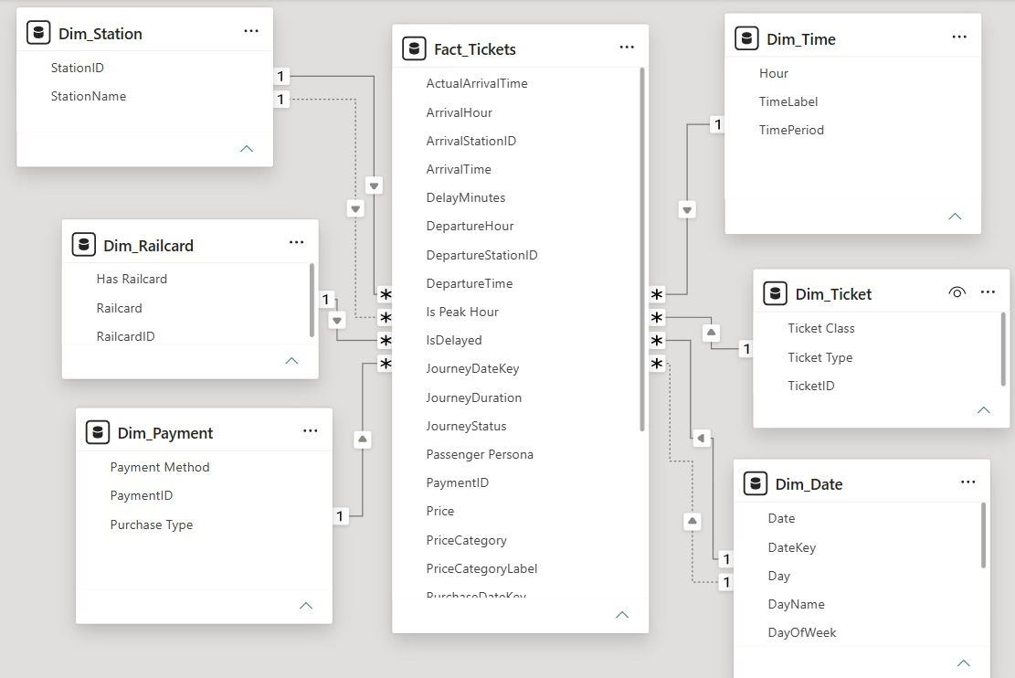
DATA MODELING
Bilal Abo Nar
Star Schema Data Model
8 RELATIONSHIPS
1 Fact table (Fact_Tickets) + 6 dimension tables
All Many-to-One, single direction
6 Active + 2 Inactive
Inactive relationships activated via USERELATIONSHIP() in DAX
WHY STAR SCHEMA?
Optimized Power BI query performance
Clean Fact / Dimension separation
Handles Role-Playing Dimensions elegantly
Follows Data Warehousing best practices
20
Notes:
From a flat table, we designed a Star Schema with 1 fact table and 6 dimension tables, connected by 8 relationships — 6 active and 2 inactive, activated using USERELATIONSHIP().

Slide 21
BUSINESS LOGIC
Bilal Abo Nar
DAX Measures & Dashboard Pages
50+ ADVANCED DAX MEASURES — BY CATEGORY
Category | Examples | Key Functions
Revenue | Total Revenue, Avg Price, Peak Revenue Share | SUM, AVERAGE, DIVIDE
Operations | On-Time Rate, Delay Rate, Cancellation Rate | CALCULATE, DIVIDE
Time Intelligence | Revenue MoM %, Trips MoM % | VAR + month comparison
Role-Playing | Arrival Station metrics, Purchase Date | USERELATIONSHIP()
INTERACTIVE FEATURES
Interactive navigation between pages
Dynamic KPI cards
Cross-filtering across visuals
Drill-down analysis
Dropdown slicers (Month, Station, Ticket Type)
Conditional formatting (🟢 🟡 🔴)
DASHBOARD PAGES
Page | Purpose
🏠 Cover Page | App-like landing with navigation buttons
📊 Executive Overview | KPI cards, revenue trend, status donut, top routes
💰 Revenue Analysis | Heatmap (Day × Hour), class breakdown, payments
🗺️ Route & Network | Top routes combo chart, station matrix
⏱️ Operations & Performance | Delay trends, delay reasons, station stacked bars
🎫 Tickets & Pricing | Ticket trends, Railcard impact, lead days
👤 Passenger Experience | Refunds, persona mix, peak-hour behavior
21
Notes:
We built 50+ DAX measures across categories, and designed 7 interactive dashboard pages covering every angle of the project.

Slide 22

DASHBOARD · COVER
Bilal Abo Nar
An App-Like Entry Point
COVER PAGE
Cinematic full-bleed hero visual sets the tone before any numbers appear
Icon-based navigation bar previews all 6 analysis pages
Establishes a consistent dark, glowing rail-signal theme carried through the whole dashboard
22

Slide 23
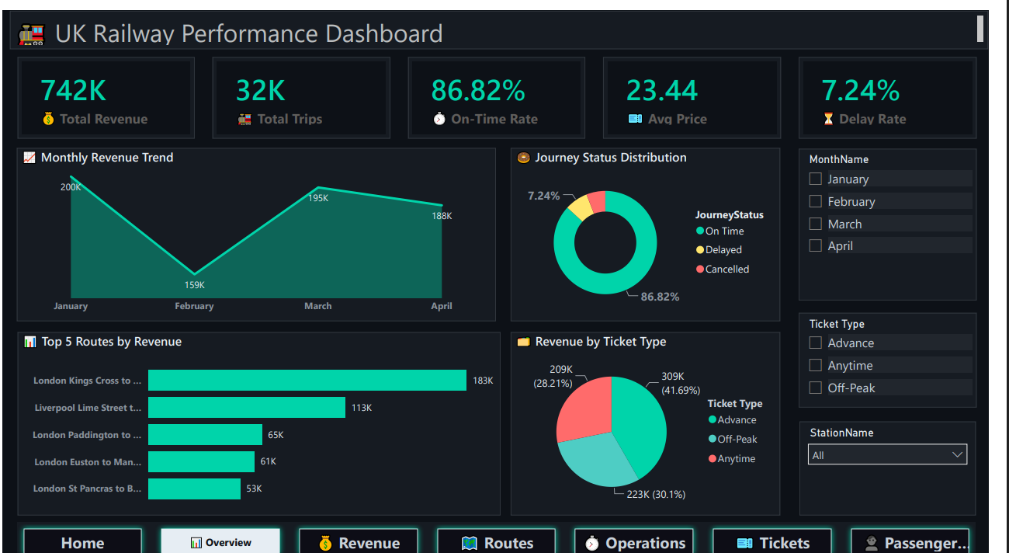
DASHBOARD · EXECUTIVE OVERVIEW
Bilal Abo Nar
The Story at a Glance
EXECUTIVE OVERVIEW
5 KPI cards: Revenue, Trips, On-Time Rate, Avg Price, Delay Rate
Monthly Revenue Trend line — January peak, February dip, spring recovery
Journey Status donut — 86.82% On Time at a glance
Top 5 Routes by Revenue, ranked
23

Slide 24
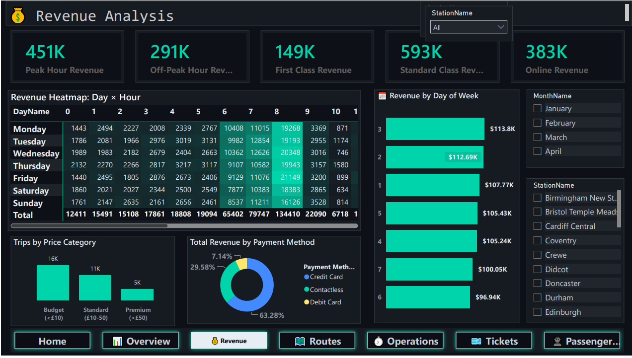
DASHBOARD · REVENUE ANALYSIS
Bilal Abo Nar
Where the Money Comes From
REVENUE ANALYSIS
Day × Hour revenue heatmap pinpoints exactly when revenue peaks
Peak Hour Revenue (£451K) vs Off-Peak (£291K)
First vs Standard Class and Online vs Station revenue split
Payment method breakdown — Contactless leads at 63.28%
24

Slide 25
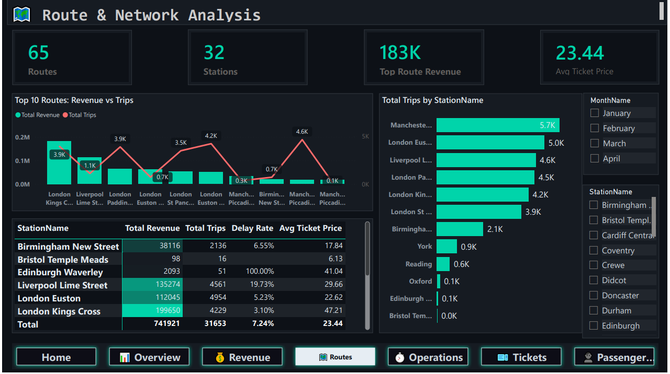
DASHBOARD · ROUTE & NETWORK
Bilal Abo Nar
Mapping the Network
ROUTE & NETWORK ANALYSIS
Combo chart: Top 10 routes by revenue vs trip volume
65 routes across 32 stations, fully filterable
Station-level table: revenue, trips, delay rate & avg price side by side
London Kings Cross leads with £199,650 in revenue
25

Slide 26
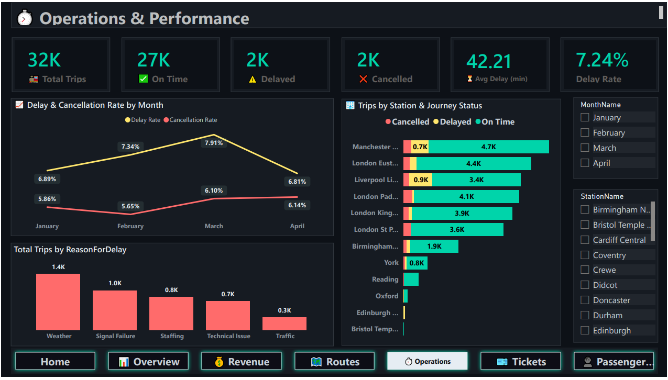
DASHBOARD · OPERATIONS & PERFORMANCE
Bilal Abo Nar
Where Reliability Breaks Down
OPERATIONS & PERFORMANCE
27K on-time vs 2K delayed vs 2K cancelled, tracked monthly
Delay & cancellation rate trend line across all 4 months
Root-cause bar chart: Weather is the #1 reason for delay
Station-level breakdown of journey status
26

Slide 27
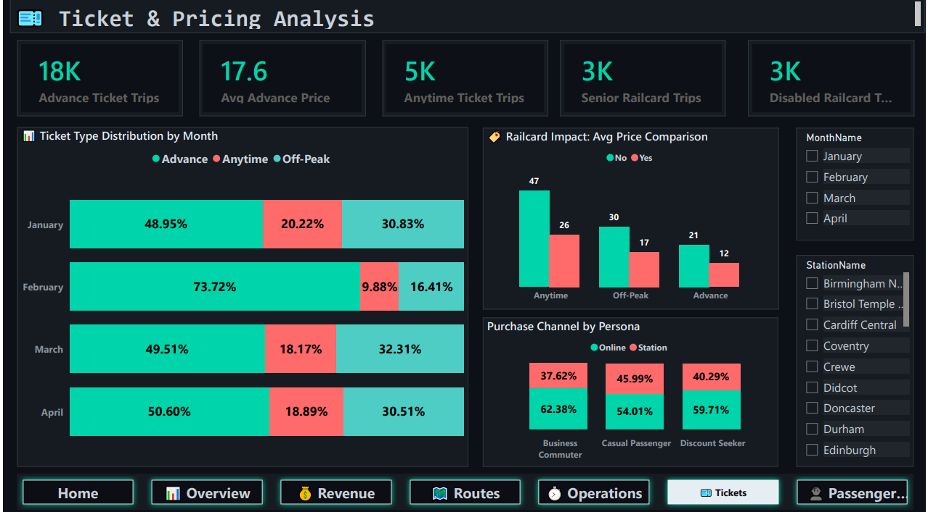
DASHBOARD · TICKETS & PRICING
Bilal Abo Nar
How Passengers Buy
TICKETS & PRICING ANALYSIS
Ticket type mix by month (Advance / Anytime / Off-Peak)
Railcard impact on average price across ticket types
Purchase channel by passenger persona — Online vs Station
18K Advance tickets at an average price of £17.6
27

Slide 28
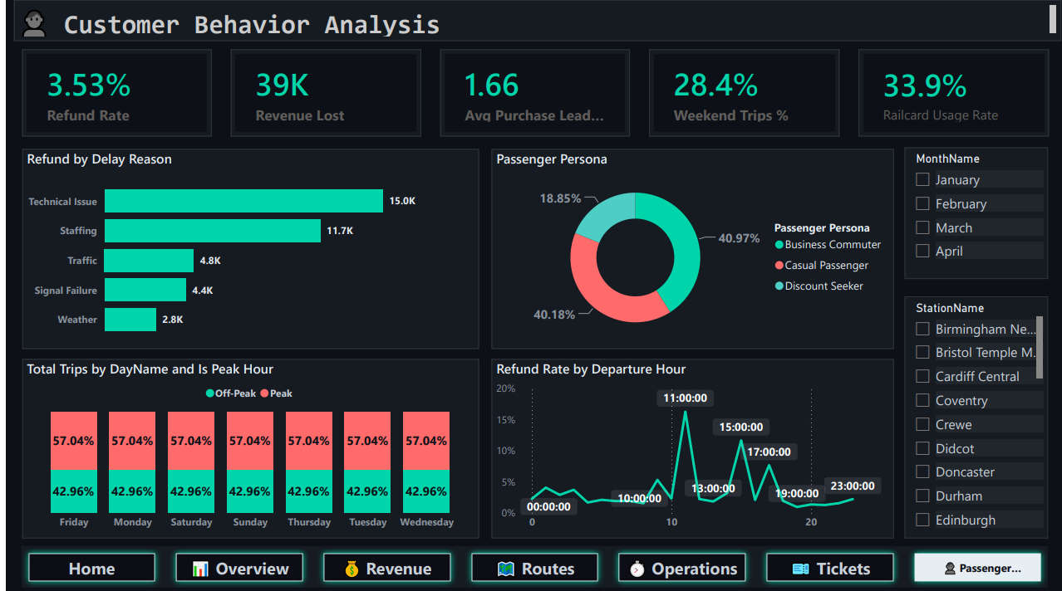
DASHBOARD · PASSENGER EXPERIENCE
Bilal Abo Nar
Understanding the Rider
PASSENGER EXPERIENCE & BEHAVIOR
Refund rate 3.53% · £39K in revenue lost to refunds
Passenger Persona split: Business Commuter, Casual, Discount Seeker
Refund rate by departure hour — spikes around 11 AM
Peak vs Off-Peak trip share is a consistent 57 / 43 split
28

Slide 29
WHAT THE DASHBOARD REVEALS
Bilal Abo Nar
Dashboard Key Highlights
£742K
31,653
86.8%
Total Revenue
Total Trips
On-Time Rate
TRENDS & OPERATIONS
INTERACTIVE FEATURES
Revenue Trend: January highest (~£200K) → February dip (£159K) → steady spring recovery
Revenue Heatmap: peak hours (7–9 AM, 4–6 PM) drive the majority of daily revenue
Top Route: London Kings Cross → York = £199.6K (highest revenue route)
Standard Class alone generates £593K — nearly 80% of total revenue
Delay Cause #1: Weather · Avg delay: 42.2 minutes
Navigation buttons: cover page → any dashboard page
Dropdown slicers: Month, Station, Ticket Type
Cross-filtering: click any visual, all others respond
Conditional colors: 🟢 Good / 🟡 Warning / 🔴 Critical (DAX-driven)
29
Notes:
The dashboard shows revenue peaked in January, the Kings Cross to York route leads in revenue, and weather is the top delay cause.

Slide 30
05
SECTION 05
Insights &
Recommendations
What the numbers tell us — and what to do about it
PRESENTED BY ESRAA NAGY

Slide 31
WHAT WE LEARNED
Esraa Nagy
Key Insights
£742K
31,653
86.8%
42.2 min
Total Revenue
Total Trips
On-Time Performance
Average Delay
ROUTES & PRICING
SERVICE RELIABILITY
Highest revenue route: London Kings Cross → York (£199.6K)
Highest average ticket price: Liverpool → London Euston
Peak travel hours: 7–9 AM & 4–6 PM
Top delay cause: Weather
Signal failures & technical issues are the leading preventable causes
Disruption patterns concentrate around peak commuting hours
31
Notes:
Key results: total revenue of £742K, the top route is Kings Cross to York, and weather is the leading delay cause.

Slide 32
TURNING INSIGHTS INTO ACTION
Esraa Nagy
Business Recommendations
Increase train frequency during peak hours
Improve infrastructure to reduce signal failures
01
02
Focus investment on high-revenue routes
Enhance weather disruption management
03
04
Promote digital ticket purchases
Optimize pricing strategies
05
06
32
Notes:
Based on our findings, we propose a set of recommendations to improve the railway network's operational and financial performance.

Slide 33
WHAT WE DELIVERED
Esraa Nagy
Project Outcome
Improved Data Quality
From raw, inconsistent records to a fully cleaned, validated dataset
Interactive Business Dashboard
7 dashboard pages built on an optimized Star Schema model
Actionable Insights
Clear, data-driven recommendations for operational & financial decisions
Enhanced Reporting Performance
Optimized data model delivers fast, reliable Power BI reporting
33
Notes:
The project ultimately delivered clean data, an interactive dashboard, and actionable insights to support decision-making across the railway network.

Slide 34
KEY TECHNICAL CHALLENGES
Bilal Abo Nar
Challenges We Overcame
Challenge | Solution
Inconsistent delay labels ("Signal failure" vs "Signal Failure") | Standardized 8 → 5 clean categories
87% nulls in Reason for Delay | Context-aware filling: "No Delay" for on-time trips
Power BI auto-typed DateKey (20240101) as a plain number | Explicit M-code type enforcement across all 7 tables
Role-Playing Dimensions (1 table, 2 purposes) | Active/Inactive relationships + USERELATIONSHIP()
Unicode encoding issues in the Route column | ASCII replacement + UTF-8 BOM encoding
34
Notes:
We faced several technical challenges while cleaning the data and building the model, from inconsistent delay labels to role-playing dimension issues.

Slide 35
Thank You!
UK Railway Performance & Passenger Behavior Analysis
Team: Bilal · Shehab · Esraa · Zeyad · Youssef
Instructor: Dina Ezzat
Track: DEPI — Data Analysis Specialist

